Slide 1
Cap Store Application

Slide 2
Sindhu Murali - 152993 JEE Full Stack - MIPL

Slide 3
Modules Assigned
CapStore Home Page
Product Page
WishList
Similar Products

Slide 4
Modules Owned:
WishList Backend
Notes:
Usar para separador de capitulos . Seria bom ter esta versao em vermelho e verde tb..

Slide 5
Softwares Used
• JDK 10
• Spring Boot 2.x
• My SQL 5.x
• SQL Yog 8.5
• Spring Tool Suite 3.9.x
• Spring Boot Data
• Spring Boot Rest Controller
• JSP – Front-end
• Jenkins – Build Server
• Git - Source Code Repository
• Postman

Slide 6
Tables involved
Wish List
Inventor
Customer

Slide 7
Wish List
Name | Data Type | Constraints | Description
WishList_id | Int | Primary_key
Cust_id | Int | Foreign_key | Recognisation of customer
Product_id | Int | Foreign_key | To Recognize Products
isActive | Varchar |  | Indicates the status

Slide 8
Inventory Table
Name | Data Type | Constraints | Description
Product_id | Int | Primary_key | To Get Details for Particular Product.
Customer Table
Name | Data Type | Constraints | Description
Customer_id | Int | Primary_key | To Get Details for Customer Logged in.

Slide 9
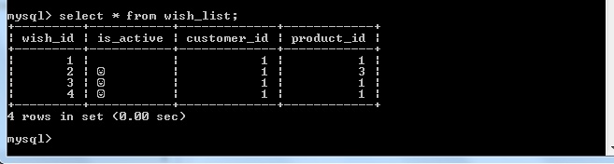
Wish List table
The product id 1 of customer id 1 is not liked by the customer.

Slide 10
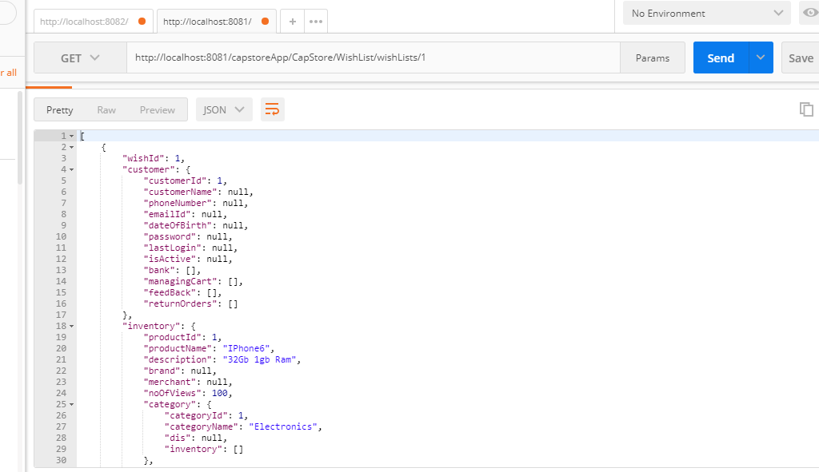
Wish List Backend
Performs getall(), create, update and remove functions.

Slide 11
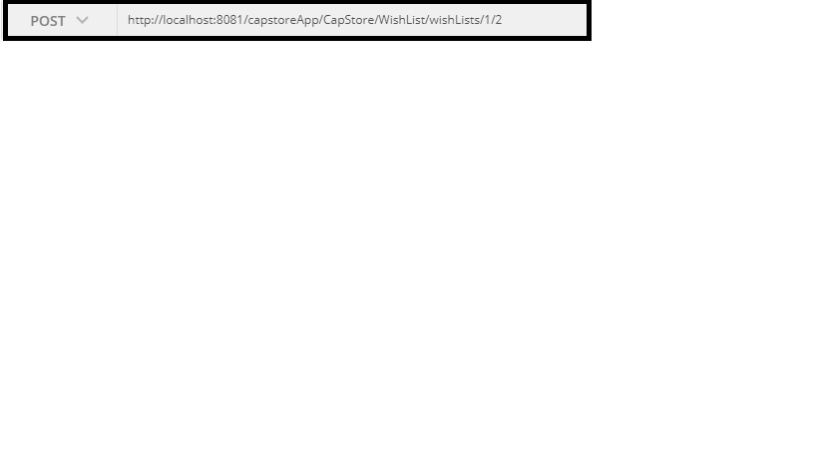
Post function
Customer Id and Product Id are given as Path Variables.
The product Id 2 will be recorded in the wish list table.

Slide 12
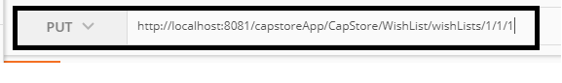
Update function
Cutomer Id, Product Id, WishList id are given as path variables.
The isActive field of Wish List will be taken as false.

Slide 13
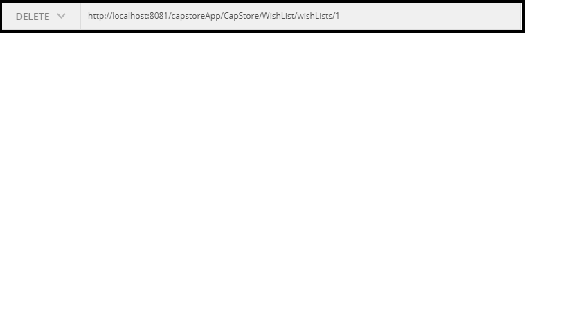
Delete function
Delete function deletes the row where wishId = 1

Slide 14
Thank You
Notes:
EVITAR usar o spada branco – tem que ser sempre o colorido.

